Slide 1
We have talked about
Go Kits
72 hour kits
Emergency Forms
Protocol
Keeping your radio equipment ready
Now, we are going to talk about….

Slide 2
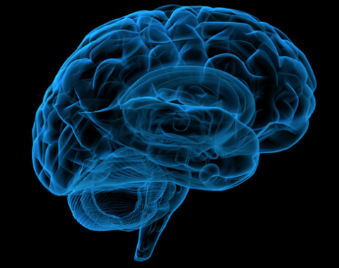
Your Brain in an Emergency
Give it some thought!

Slide 3
Disclaimer
I am not a psychologist
I am not a doctor
I am not an expert on the subject
I just want to give you some insight from articles found online.

Slide 4
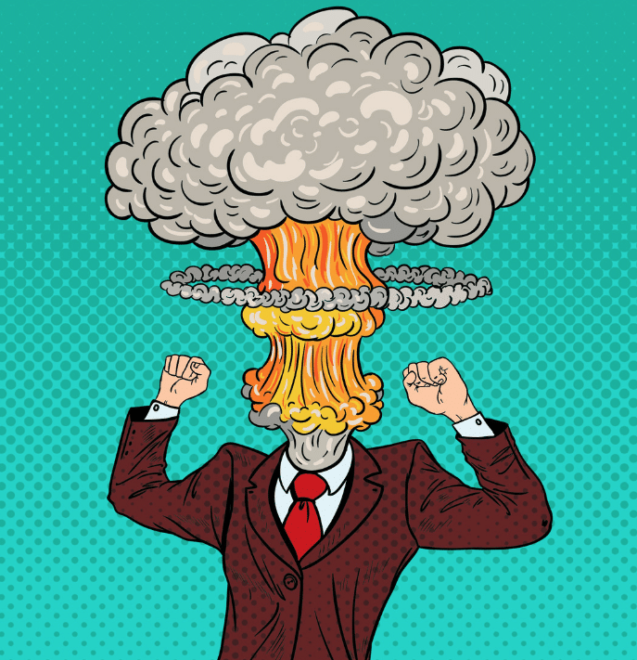
OK. Something happens, and your brain is screaming “red alert”.
What you do next determines how the rest of the story goes and how you experience the situation.

Slide 5
Your amygdala, which is part of the limbic system, acts as the brain’s threat radar and alarm. It’s constantly scanning your environment for signs of danger, ready to activate reflexes to keep you safe.
When this happens, most of your physical and mental resources get allocated to making sure you survive.

Slide 6
When this happens, most of your physical and mental resources get allocated to making sure you survive.
Your thinking, rational brain shuts down.
Basically, your brain eliminates all unnecessary functioning preparing you to fight or flee.

Slide 7
Switch the part of your brain in control.
Slow your breathing.
Support yourself with your self-talk.
“I can handle this. I can figure it out.”
“Things can turn out OK. I’ve been through tough situations before and they ended up OK.”
“Take it one thing at a time. All I have to do is figure out the next best step.”

Slide 8
Switch the part of your brain in control.
You can consciously choose to help yourself through it – whatever “it” is – and let the frontal lobe, your thinking brain, take control.
Deliberately shifting control of your thoughts and actions from your limbic system to the conscious awareness of your frontal lobe is really what is happening in your brain with mindfulness.
When you are mindful, your frontal lobe “talks to” and influences other areas of your brain to insert rational thinking and calm them down.

Slide 9
Slowing your breath is the quickest way to calm your brain and body. It’s kind of like your remote control. You don’t have to think about breathing. It’s subconscious. However, at any moment, you can consciously change how you are breathing which simultaneously alters your emotions and nervous system function.

Slide 10
The situation then becomes a tool with which to work for your growth and learning. This choice builds and reinforces the anti-anxiety pathways in your brain and calms the amygdala.

Slide 11
What would be your first response to….
We just had an earthquake!
There is a fire in your building!
Lightning just struck the building next to you!
High winds just toppled a tree onto your home!
Someone just collapsed beside you!
You find yourself in a life-threatening situation!

Slide 12
What do you do?

Slide 13
What do you do?
Well, that depends

Slide 14
What do you do?
Every one of us is at risk for these kinds of unexpected intrusions into our day-to-day lives.

Slide 15
What do you do?
Every one of us is at risk for these kinds of unexpected intrusions into our day-to-day lives.
What you do about it depends on whether or not you’re prepared – not just physically, but also mentally.

Slide 16
Some basics
In any situation, some things are likely to be out of your control: How much damage will there be? How big is the fire? Are there injuries or deaths?
Some things, however, are up to you. Being aware of how you might react can go a long way toward making a bad situation better.

Slide 17
Some basics
In a crisis, your brain is going to want to make decisions, and not always the best ones.

Slide 18
Some basics
In a crisis, your brain is going to want to make decisions, and not always the best ones.
The good news is there are steps you can take to be a better decision-maker in emergencies.

Slide 19
Some basics
In a crisis, your brain is going to want to make decisions, and not always the best ones.
The good news is there are steps you can take to be a better decision-maker in emergencies.
There is science behind the way people react to stressful situations, and we can use it to our advantage.

Slide 20
Some basics
Science tells us that people behave in high stress incidents in certain ways. What you do will be dependent in large part on what your stress level is.
If your heart rate soars above about 175 beats per minute, you’re more likely to go into shutdown mode and not be able to think clearly or act.

Slide 21
A little more
During the decision-making process, your mind will most likely move through three stages:
Denial
Deliberation
Decisive action
Knowing these stages – and preparing for them ahead of time – can help you recognize and deal with what’s going on around you more effectively.

Slide 22
Denial: This is not happening
Have you ever heard gunfire in your neighborhood and blamed it on a firecracker? That’s denial. And it’s perfectly normal. We don’t want to believe bad things are happening. We don’t want to panic or look silly.
In emergencies, we often look to people around us for cues about what we should do. (Is everyone else running and screaming, or are they sitting quietly in their chairs? Are others stopping to help?)

Slide 23
This is known as social proof.
Social proof is a psychological phenomenon that happens whenever people aren’t sure what to do. We assume others around us know more about the situation, and so we do what they do, whether it’s the right thing or not.
We also know that a person is less likely to take responsibility when others are present. We assume that other people are responsible for taking action, or that they’ve already done so.

Slide 24
This is called diffusion of responsibility
It means you’re actually more likely to get help when you’re with a single person than when you’re in a large group of people.

Slide 25
This is called diffusion of responsibility
It means you’re actually more likely to get help when you’re with a single person than when you’re in a large group of people.
It can be tough to take charge.

Slide 26
This is called diffusion of responsibility
It means you’re actually more likely to get help when you’re with a single person than when you’re in a large group of people.
It can be tough to take charge.
You do the best you can.

Slide 27
Deliberation: What are my options?
Once you’ve recognized the emergency, you’ll begin to consider your options. If you’re smart, you’ve already started this process before the emergency happens.
Maybe you participated in a fire drill at work
Or you counted exactly how many rows there are between you and the emergency exit on the plane,
You took a first aid class in your community
You became a licensed ham radio operator. (More about that later)

Slide 28
Being Prepared
The more you’ve prepared, the more options you’ll have to work with.
Everybody hates the idea that we practice for emergency events. Fire drills… ugh.
But it’s practice, and practice helps you understand what to do or how to react when you don’t have a lot of time.
Not only can practice save your life, but if you know how to save yourself, emergency responders on the scene can use their time and effort to save others. You’re one less person who needs saving, and that saves lives.

Slide 29
Decisive action: It’s go time!
You’ve acknowledged there’s a problem. You’ve considered your options. The next step is to take decisive action. With all the information you have, what are you going to do next?
Now is the time to put your plans into motion. Go to the exit, call for help, take cover, give CPR… whatever you’ve decided to do.
In most crisis situations, there is no definite right or wrong. There is no perfect way – only the best we can do. The most important thing is to do something. In almost every case, an imperfect plan is better than no plan, and action is better than inaction.

Slide 30
Plan Now!
Remember, if you depend on everyone else to take care of you, you’re leaving the most important person out. Don’t wait to make a plan. Know yourself, know your situation, and be prepared to save your own life.

Slide 31
Now let’s get specific
Communication is a vital aspect of every emergency
Your knowledge and performance is key to improving the situation.

Slide 32
You are a licensed ham radio operator
You have the skills necessary to communicate the situation.
You are a leader.
You can take charge when necessary.
You can do your best to improve your skills
You are part of a team.

Slide 33
It’s Go Time
The future of our club depends on you.
We need you to become proficient in being a Net Control Operator
Your Role is to
Improve your radio skills
Communication skills
Leadership skills.

