Slide 1
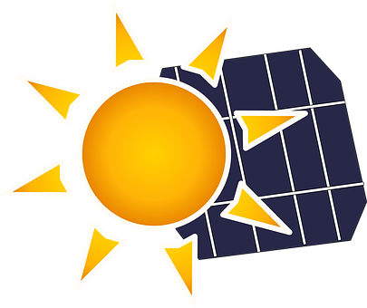
Solar Power for Ham Radio

Slide 2
Please Understand
I am not an expert on solar energy or any of the related components.
What I am sharing with you is based on my personal experience using solar power with my ham shack radios and my RV.
I have found it to be a reliable source of power in both situations.
As you choose to invest in the equipment, you will find it to be a bit pricey but well worth the expense in my opinion.

Slide 3
SAFeTY
Whenever you are working with anything electrical, use good safe practices
This includes working with Solar equipment.
Even DC voltage can be dangerous.

Slide 4
Solar Power Primer
Portable solar power systems for HAM Radios can be very useful during times of emergencies.
They can help you maintain your communication abilities.

Slide 5
Solar Power Primer
As long as the sun is shining, you can capture some of that energy and convert it to keep your batteries charged.
No Sun? You will need to fall back to other sources of electricity to keep your radios running. i.e. generators, car batteries, etc.

Slide 6
Benefits of solar for portable ham radio operations
Traditionally, operators deployed with lead-acid batteries and would carry “enough” battery storage to last them the day.
Recharging was done by use of a generator or batter charger when they had line power.

Slide 7
How much solar do you need?
Before we dig into the different aspects of a portable solar solution for ham radio, it’s vital to understand our power budget clearly. A well thought out power budget determines the batteries we need and the solar panel we select.

Slide 8
What affects solar efficiency?
Weather can play a critical role in solar system use.
Consider the short-term weather forecast.
Clouds will reduce the amount of solar panel output

Slide 9
Understand your operating environment
Your operating environment will dictate what kind of solar panels you need to take with you.
How many hours of sunlight can you reasonably expect?
Will there be times your location will be shaded?

Slide 10
What do you really need?
How much power you use is dependent on how often you transmit vs. receive.
Can you prioritize your transmissions?
Can you transmit at a lower power level?
Keep your transmissions short and to the point.

Slide 11
Step one in the process
Determine how much power you use when operating to figure out the wattage you need from your solar panels.
Using an inline amp meter will help you determine your solar needs. Measure how much power you are consuming for a day.
.

Slide 12
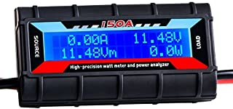
The inline meter and how it works
The meter will provide real time readings of the amps, volts, watts and amp hours (ah) while operating.

Slide 13
Battery Storage
You want to start your deployment with a full battery pack.
The solar panel’s job is to keep the battery topped up.
Revert back to using our battery storage during darkness
Generators can keep your batteries charged when needed.
Under heavy use, you may need to use a combination.

Slide 14
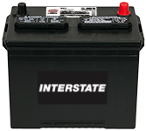
Standard Lead-Acid batteries
Flooded or "wet cell" batteries are the most commonly used batteries on the market today.
Usually flooded batteries are not sealed, and do not recombine the gases to liquids internally.
Flooded batteries do require maintenance, in the form of water, to routinely replenish lost electrolyte through the vents.

Slide 15
Sealed lead-acid batteries
A sealed lead acid battery (SLA) is a lead – acid battery that has the sulfuric acid electrolyte coagulated (thickened) so it cannot spill out. They are partially sealed but have vents in case gases are accidentally released for example by overcharging.

Slide 16
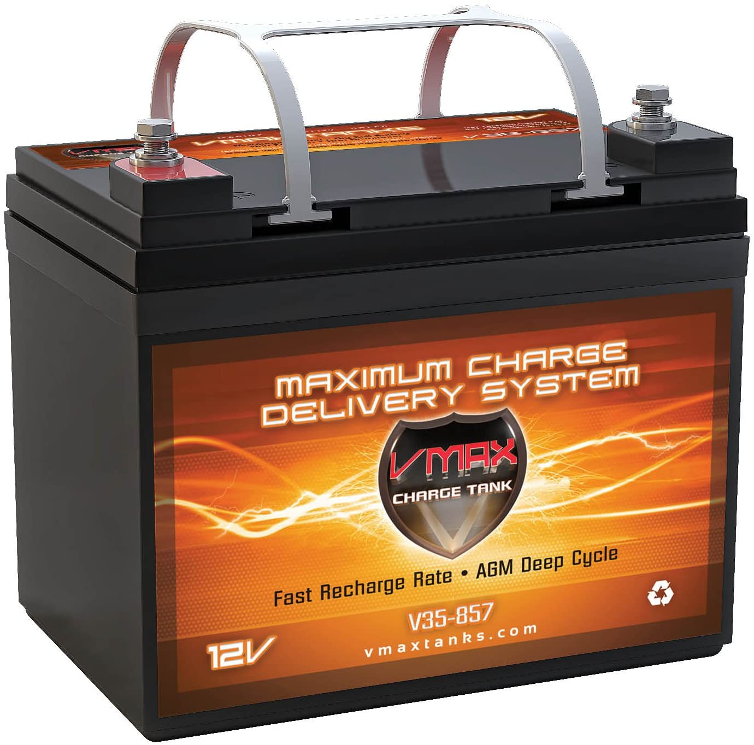
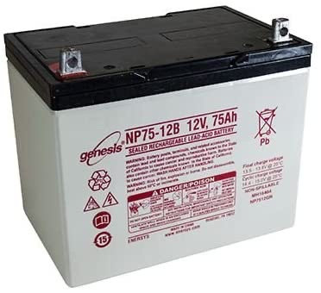
AGM – absorbed glass mat batteries
An AGM battery uses a separator consisting of fiberglass between the plate and wrappers to hold the electrolyte in its place with capillary action.
This capillary action holds the liquid inside the glass matting, making the AGM Battery "spill proof" if it is ever exposed.
Premium AGM batteries recombine the gases produced internally, back into liquid. This recombination makes the AGM battery maintenance free.

Slide 17
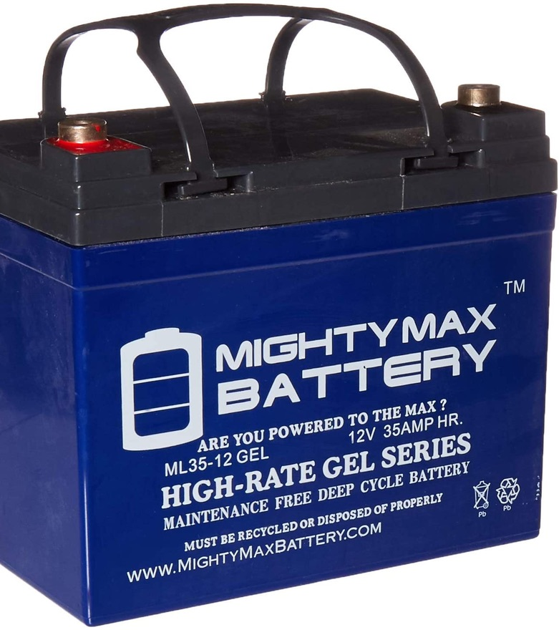
Gel-cell batteries
GEL cell batteries are also sealed just like the AGM battery in the previous slide.
A GEL battery uses a silica (sand) to turn the sulfuric acid into a jelly like substance.
This jelly is then used as the electrolyte
The term SLA and GEL is often referred to as similar construction

Slide 18
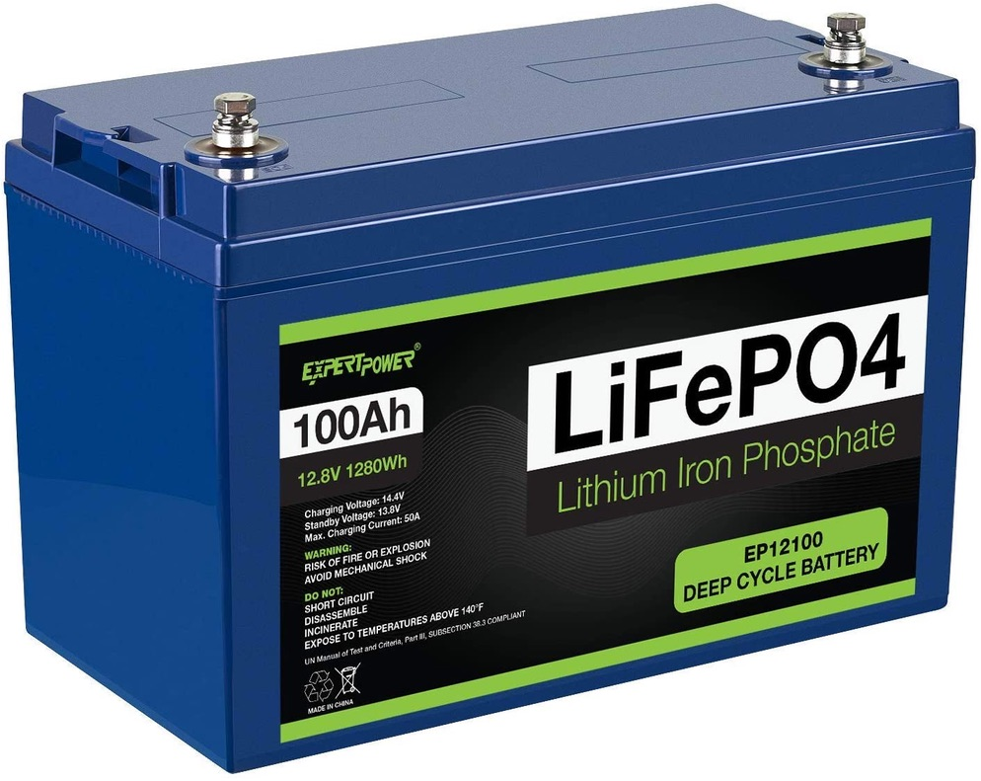
Lithium batteries
Lithium-ion batteries are made from what are called cells. Every cell is composed of three components; a positive electrode, a negative electrode, and a chemical component called an electrolyte between the positive and negative ones.

Slide 19
Lithium batteries
The positive electrode in the cell is designed from Lithium-Cobalt oxide. The negative electrode is designed from graphite. The electrolytes are typically oxides and sulfides. The electrolyte must have a long shelf life and offer high mobility for Lithium ions. The electrolyte can be liquid, polymer, and solid-state ones..

Slide 20
Lithium batteries
Lithium batteries are about 1/3 the weight of lead-acid, SLA, AGM and GEL-Cell
They are significantly much more expensive
They offer longer recharging life cycles
They have excellent discharge patterns.

Slide 21
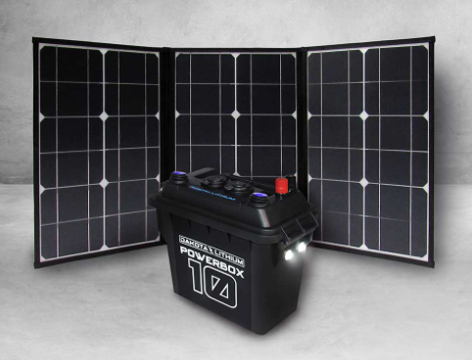
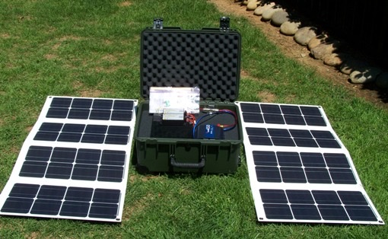
Solar Panels

Slide 22
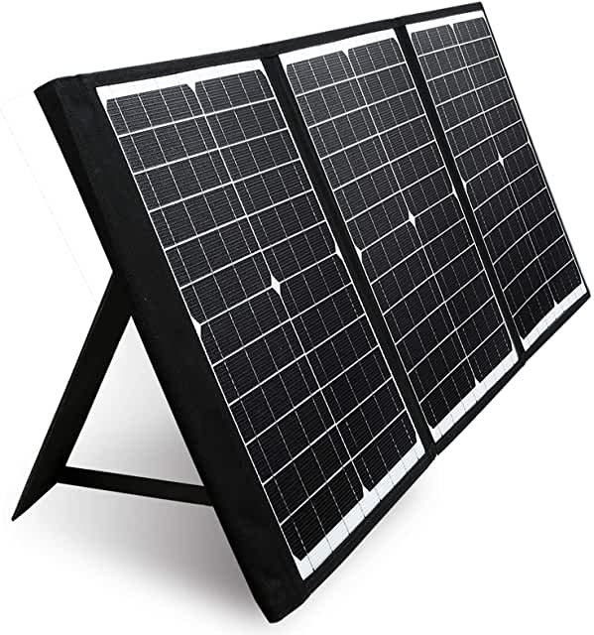
Monocrystalline silicon
Sometimes called Mono-Si or single-crystalline silicon, monocrystalline silicon solar panels are the most common among the three types of solar panels.
They're made by adding a crystalline seed that solidifies the silicon, it's shaped into bars and then cut into the squares that make up the panel.
The resulting material is high quality, with consistent crystalline structures that enhance the panels' efficiency.
The panels typically have cells with the corners cut off, giving them a characteristic look. They typically look black in color.

Slide 23
Advantages of these panels include:
High solar panel efficiency ratings ranging from 15 to 20 percent or better, as noted by Energy Informative.
Space efficiency requiring the least amount of space compared to other types of solar panels.
They're the most durable and typically come with a 25-year warranty.

Slide 24
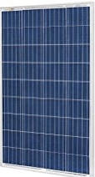
Polycrystalline silicon
Often called p-Si or multi-crystalline silicon.
Polycrystalline silicon solar panels are made by melting raw silicon. That gets poured into a mold that's cooled before cutting it into perfect squares, giving these solar panels a different look than their Mono-Si counterparts. Because the process is simpler, these solar panels are also less expensive. The solar panel efficiency ranges from 13 to 16 percent on average. Additionally, they do take up more space.
These panels are typically blue in color.

Slide 25
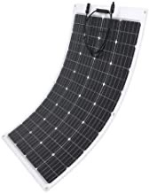
Thin-Film
Thin-film solar panels are manufactured differently than other types of solar panels. They're made by layering photovoltaic materials like cadmium telluride, organic photovoltaic cells, amorphous silicon or copper indium. Depending on the type of material used, the efficiency of this type of panel runs up to around 13 percent or so, according to Energy Informative. Because they're easy to make, they're typically less expensive.
They are lighter than rigid frame panels.

Slide 26
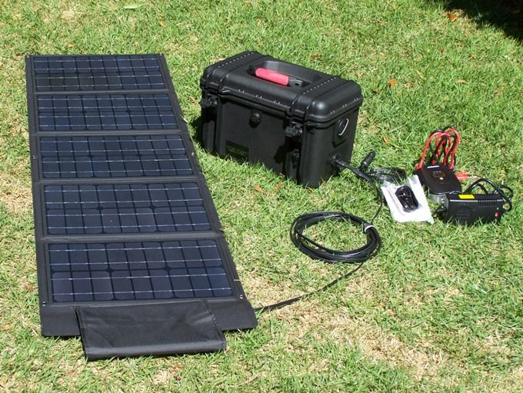
Foldable or suitcase
These are very convenient to transport and easy to store.
They come in different output ranges
They typically cost more that rigid flat panels
They can be laid flat, but some can be tilted to face the sun more effectively.
This type is a good choice for backpackers

Slide 27
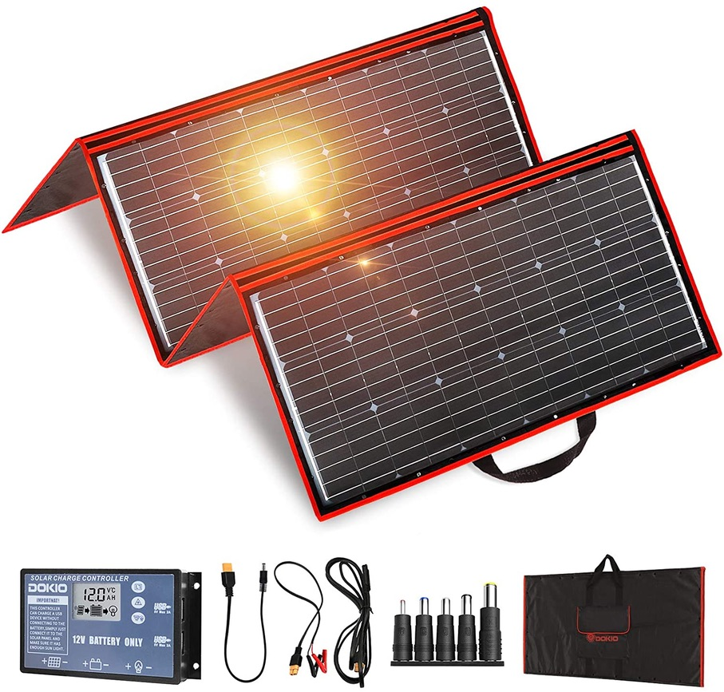
Foldable or suitcase
Another example

Slide 28
Why do you need a controller?
Batteries have unique charging requirements for optimum performance. Solar modules have unique electrical characteristics that change throughout the day.
You need something to make the two systems compatible.

Slide 29
Charge Controllers
A solar charge controller is a device that manages the charging of a battery from a solar module or array of modules. Solar charge controllers come in three types, though the market is dominated more and more by just one of those.

Slide 30
Shunt Controller
Not really “applicable” for our purposes! So FYI
A shunt controller is just an ON/OFF switch. When the battery voltage is low (needs a charge) the switch turns ON and energy flows from the solar array to the battery. When the battery voltage is high (charged) the switch turns OFF and charging stops.
Shunt controllers are the simplest type but also the most basic and crude and offer the least efficient battery charging. (Imagine trying to fill a glass with water from a kitchen tap that only had 2 settings: OFF or full ON.) There are few shunt controllers available today and only in small sizes and generally for specific applications.

Slide 31
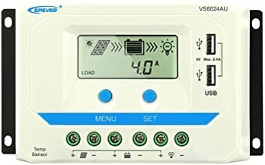
PWM Controller
Pulse Width Modulation = PWM
If you take a shunt controller and turn the switch ON and OFF rapidly you can control the average charging voltage that is applied to the battery. That’s PWM, or Pulse Width Modulation.

Slide 32
PWM Controller
This technology allows for multi-stage charging including Bulk, Absorb, and Float stages, which significantly improves charging efficiency and charging control, thus improving battery performance and lifespan.

Slide 33
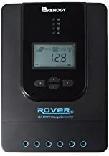
MPPT Controller
Maximum Power Point Tracking = MPPT
These are the most popular and effective controllers for our purposes.

Slide 34
MPPT Controller
If we are to achieve maximum efficiency and effectiveness in charging, we need some kind of conversion or translation device that allows the solar array to operate at maximum efficiency while, at the same time, providing optimal charging to the battery.

Slide 35
MPPT Controller
That’s exactly what an MPPT, or Maximum Power Point Tracking controller does – it operates the solar array at its point of maximum power (the Maximum Power Point, or MPP) and independently applies optimal charging to the battery bank.

Slide 36
MPPT Controller
The vast majority of solar charge controllers in use today are MPPT controllers
MPPT controllers often have superior programmability and features like data logging, which can be very valuable for troubleshooting.

Slide 37
In summary
The approach with solar is to be able to use a widely available source of energy (the sun) to the extent of its daily availability (daylight hours) to achieve a longer term of use of its energy use by storing that energy in a good battery or battery bank.
I use monocrystilline panels with gel cell batteries in both my shack and RV.

